Slide 1
Problem Statement
Human Activity Recognition or HAR for short, is the problem of predicting what a person is doing based on a trace of their movement using sensors.
Movements are often normal indoor activities such as standing, sitting, jumping, and going up stairs. Sensors are often located on the subject such as a smartphone and often record accelerometer data.
It is technically challenging because of the large volume of sensor data collected (e.g. tens or hundreds of observations per second).
More recently, deep learning methods have been achieving success on HAR problems given their ability to automatically learn higher-order features
The activities were performed and recorded by each subject in a continuous sequence.
The specific activities performed were:
Standing
Walking
Going Up/Down Stairs.
Walking and Talking with Someone.

Slide 2
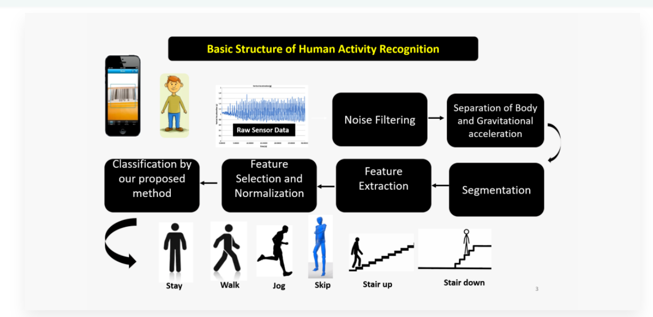
Basic structure of HAR

Slide 3

Dataset Description
The experiments have been carried out with a group of 30 volunteers within an age bracket of 19-48 years. Each person performed following activities (WALKING, WALKING_UPSTAIRS, WALKING_DOWNSTAIRS, SITTING, STANDING) wearing a smartphone on the waist. Using its embedded accelerometer and gyroscope, we captured linear acceleration and angular velocity at a constant rate of 50Hz. The experiments have been video-recorded to label the data manually. The obtained dataset has been randomly partitioned into two sets, where 70% of the volunteers was selected for generating the training data and 30% the test data.
The dataset includes the following files:
Inertial-Signals: The following files are available for the train and test data. Their descriptions are equivalent
Inertial-Signals/train/total_acc_x_train.txt:
The acceleration signal from the smartphone accelerometer on X axis .
.The same description applies for the `total_acc_y_train.txt`
and `total_acc_z_train.txt` files for the Y and Z axis
Inertial-Signals/train/body_acc_x_train.txt :
The body acceleration signal obtained by subtracting the gravity from the total acceleration
Inertial Signals/train/body_gyro_x_train.txt: The angular velocity vector measured by the gyroscope
for each window sample. The units are radians/second.
y_test.txt: Testing labels.
features_info.txt: Shows information about the variables used on the feature vector.
features.txt: List of all features.
X_train.txt: Training set.
X_test.txt: Testing set.
activity_labels.txt: Links the class labels with their activity name.
subject-train.txt: Each row identifies the subject who performed the activity for each window sample.
subject-test.txt: Each row identifies the subject who performed the activity for each window sample.
y_train.txt: Training labels.

Slide 4
Terminologies used in Dataset Description
Accelerometer -> The accelerometer is a sensor that enables users with an upgraded experience by adjusting an orientation of the app screen in the smartphone and tablet. It is an electromechanical device that measures the force of acceleration caused by movement or by gravity or by vibration.
Gyroscope->Gyroscope sensor is a device that can measure and maintain the orientation and angular velocity of an object. These are more advanced than accelerometers. These can measure the tilt and lateral orientation of the object whereas accelerometer can only measure the linear motion
Linear Acceleration-> Linear acceleration is rate of change of velocity towards time change.
Angular velocity -> The angular velocity of the object is the object’s angular displacement with respect to time when the object is moving in a circular path.

